Slide 1
BEST LOCATION FOR OPENING A COFFEE SHOP IN TORONTO
Data Science Capstone Project
Raghav Arora

Slide 2
Problem
While opening a restaurant can be a very lucrative business, a lack of demand causes many restaurants to close within the first year of opening
Factors for Restaurant’s Success: Location, Competition, Quality of Food
Business Problem: If client wants to open a Coffee Shop in Toronto, what all neighborhoods are good?

Slide 3
Data
Data Sources:
Foursquare API
Wikipedia
Used Foursquare explore API to fetch all the venues and venue categories in each neighborhood Wikipedia
Number of Coffee Shops in Each Neighborhood (Foursquare API)
- Scraped Toronto Borough and Neighbourhood from Wikipedia

Slide 4
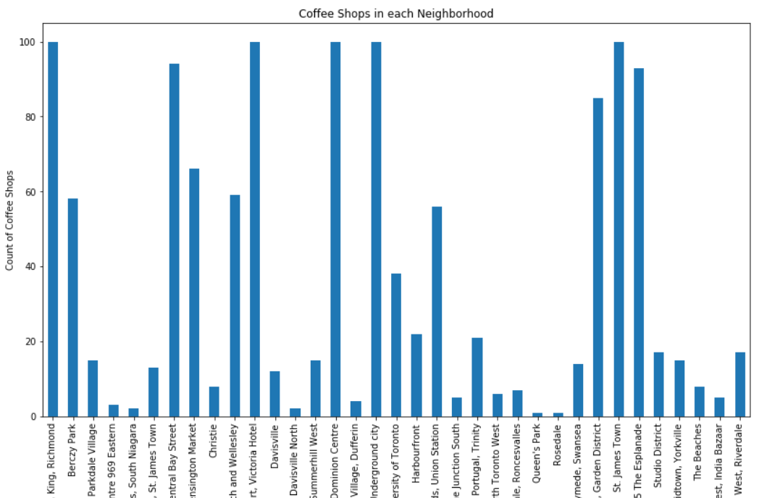
Coffee Shops in Each Neighborhood

Slide 5
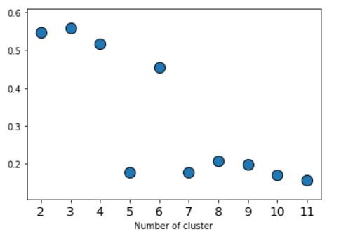
Number of Clusters : Silhouette Coefficient

Slide 6
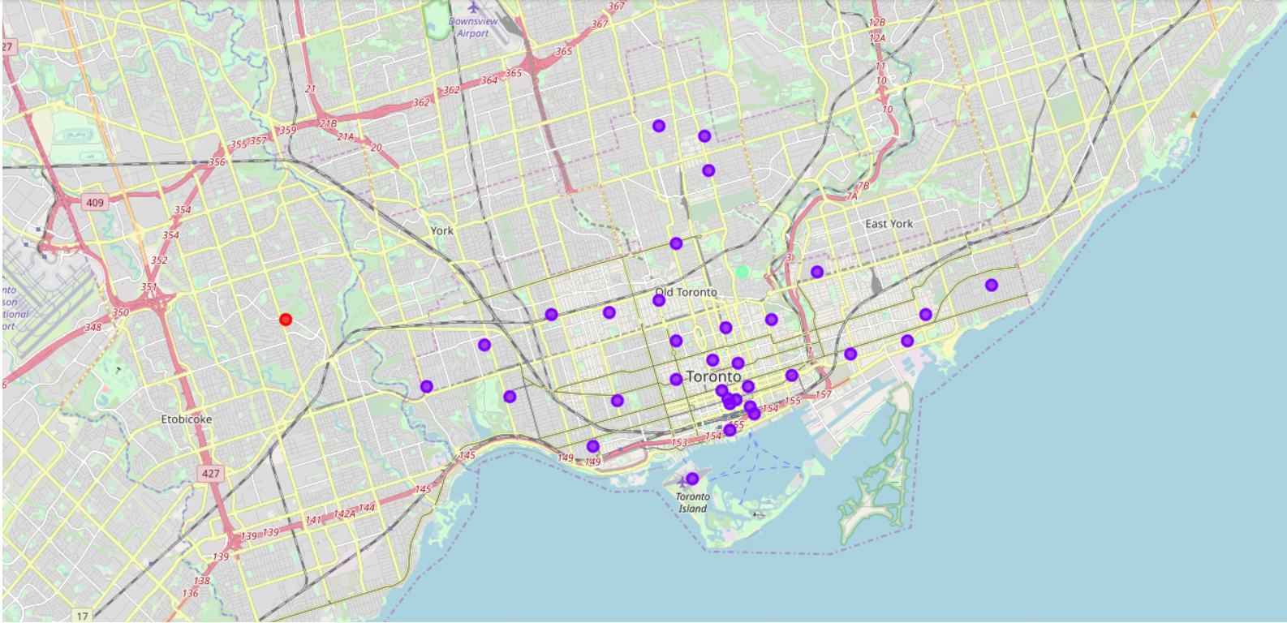
Foursqaure API
Cluster 0 = Red Cluster 1 = Purple Cluster 2 = Blue Cluster 3 = Turquoise Cluster 4 = Orange

Slide 7
Cluster | Characteristics
Cluster 0 | Only one Coffee Shop i.e. Java Joe's Village Cafe
Cluster 1 | Has 33 Coffee Shops
Cluster 2 | Only one Coffee Shop i.e. Home Coffee Solutions

Slide 8
Conclusion
The best location to open Coffee Shop in Toronto, Canada would be the Rosdale and Queen’s Park.

Slide 9
Thank you!

